Slide 1

Module six: Constitutional Law and the Internet
CYB 303 – Prof. C. R. Johnson

Slide 2
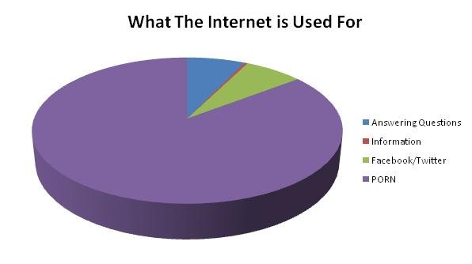
Obscenity? On MY Internet??
https://www.youtube.com/watch?v=LTJvdGcb7Fs

Slide 3
Everyone’s American
The Internet does not belong to the United States. The rights afforded to us as citizens does not extend to foreign nationals.
Still, we expect those rights to be honored regardless of where we are. For websites that reside in, or do business in, the United States, we expect those rights to be preserved.
We also cannot deny that this is the case – there have been many court cases in US jurisdictions that are decided on a Constitutional basis.
The way each nation relates to the Internet also matters and so the USA, being a big part of the Internet (though no longer the biggest) does have general influence over how the Internet operates, what’s acceptable, and what’s legal.

Slide 4
The 1st Amendment
Congress shall make no law respecting an establishment of religion or prohibiting the free exercise thereof, or abridging the freedom of speech or of the press, or the right of the people peaceably to assemble and to petition the government for a redress of grievances.
The Internet complicates the first amendment, doesn’t it?
What is press? Bloggers? Buzzfeed? The Internet puts the ability to publish into the hands of everyone – are we all “press”?
What is the limit of free speech?
Does the right to assemble extend to things like chat rooms, social media, or mass email?

Slide 5
Freedom of the Press
Not better or worse, but different:
Pre-Internet, when publishing authority was consolidated, press identification was essentially a pass affording you protection of this clause.
These limited authorities could be influenced or shut down, but the decentralization of the Internet makes that much more difficult – look at the revolutions that took place shortly after the spread of the Internet.
The question now is – who is the press? Everyone? No one? If you have X followers? Y upvotes/likes?

Slide 6
A recent case
Packingham v. North Carolina (2017):
LESTER PACKINGHAM JR. is a registered sex offender who pled guilty in 2002 to having sex with a 13-year-old girl when he was 21 years old. But in 2010, after the state of North Carolina banned Packingham from using Facebook, under a law that prohibits sex offenders in the state from using a wide swath of the internet, he decided to fight back, arguing that the ban violated his First Amendment rights.
The Supreme Court unanimously decided that Packingham was right. “Foreclosing access to social media altogether thus prevents users from engaging in the legitimate exercise of First Amendment rights,” reads Justice Anthony Kennedy’s opinion. “Even convicted criminals—and in some instances especially convicted criminals—might receive legitimate benefits from these means for access to the world of ideas, particularly if they seek to reform and to pursue lawful and rewarding lives.”

Slide 7
Freedom of Speech
Perhaps most profound is the freedom of speech in a medium that allows instant mass communication.
But there are limits to this freedom – that has been well established by the SCOTUS.
Forum moderation / Content curation : The Internet is Private Property
Freedom of Speech is does not equal freedom to be heard, or obligate others to pay attention to you.
The government may regulate speech – the time, place, and manner.

Slide 8
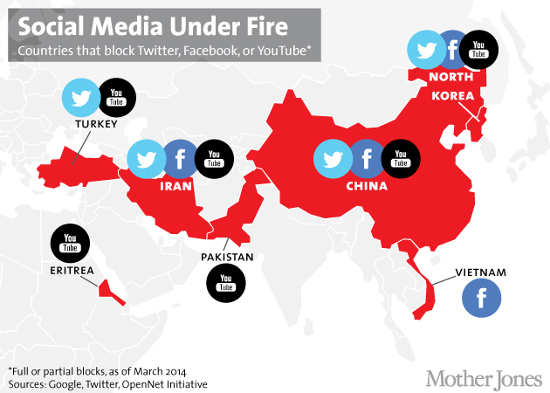

Slide 9
Case Law
Kovacs v. Cooper (1949) that “[t]he moving picture screen, the radio, the newspaper, the handbill, the sound truck and the street orator have differing natures, values, abuses and dangers. Each … is a law unto itself.”

Slide 10
Copyright
The Digital Millennium Copyright Act is passed in order to fulfill our own obligations under the WIPO World Copyright Act Treaty. There are, however, a few provisos, a few quid pro quos:
Fair use: Commentary, search engines, criticism, parody, news reporting, research, and scholarship.
Fair use does not protect someone from libel/slander/defamation – that’s a separate issue.

Slide 11
Copyright
Grey areas: Abandonware and orphan works.
Abandonware is copyright material, but the holders do not pursue copyright claims. Still infringement, but if it’s old software with no support and of niche interest, it’s not likely to be a problem.
Orphan works are those under copyright, but with no stakeholder listed. With no one on file to enforce the claim, it’s not likely to be a problem.

Slide 12
Run DMCA
The DMCA doesn’t just cover pirating copyrighted works, but also the circumvention of “technological protection measures” that “effectively control access” to such works.
Infringement also includes trademark violations, such as cybersquatting, expanded by the Anti-cybersquatting Consumer Protection Act in 1999. Trademark disputes are actionable under the Lanham Act.

Slide 13
Any port in a storm
It includes a provision for ISPs to act as a “safe harbor” (known as part of the DMCA called the Online Copyright Infringement Liability Limitation Act OCILLA) – It exempts ISPs from liability for infringement as long as they…
Do not interfere with technical measures copyright owners use to protect their works.
Comply and respond promptly to takedown notices.
Not be aware of any infringement prior to the issuance of a takedown notice.

Slide 14
Run DMCA
The broad immunity of the Digital Millennium Copyright Act’s Safe Harbor provision agrees with other provisions other regulations, like Section 230.
But that may not work for intellectual property rights, according to the US Copyright Office report on Section 512.
And certainly had problems with enforcement from nearly every perspective.

Slide 15
Speaking of Section 230
With all of the content hosted online, there surely must be a complicated compliance requirement for web-hosted content, right?

Slide 16


Section 230? Story time
Once upon a time…
Cubby, Inc. v. Compuserve
Stratton Oakmont, Inc. v. Prodigy Services Co.
“And then there was censorship. The forums were heavily moderated. Foul language and heated arguments weren’t allowed. But the censorship grew to not even being able to mention other users by name. In one infamous example, a discussion in a coin collecting forum got nuked because it used the phrase ‘Roosevelt dime.’ Prodigy happened to have a user named Roosevelt Dime.” – David Farquhar

Slide 17
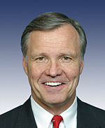
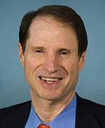
But wait… doesn’t that mean…?
Yep.
“It struck me that if that rule was going to take hold then the internet would become the Wild West and nobody would have any incentive to keep the internet civil.” Christopher Cox (R-CA), 1996

Slide 18
The Communications Decency Act
Section 230 has often been called "The 26 words that made the Internet“
Protection for Good Samaritan blocking and screening of offensive material.
No provider or user of an interactive computer service shall be treated as the publisher or speaker of any information provided by another information content provider.
Publisher vs. distributor
Indemnity does not mean immunity from public opinion.
It also never provided immunity from not responding to illegal material and copyright infringement (hence, Safe Harbor.)

Slide 19
Since 1996…
There have been some developments providing restrictions on content.
Fair Housing Council of San Fernando Valley v. Roommates.com - The site helped to match renters based on a mandatory questionnaire which included information about their race and preferred roommates' race. This created discrimination and violated the Fair Housing Act. Roommates.com was liable for this.
Why did Craigslist dump their online personals and “adult” services section? Or why Backpage.com went down? It wasn’t an attack of conscience. The FOSTA-SESTA bills (the Allow States and Victims to Fight Online Sex Trafficking Act (FOSTA) and the Stop Enabling Sex Traffickers Act (SESTA)) put limitations on section 230.

Slide 20
Decency
1996 – The Communications Decency Act is passed. It did two things: First, attempts to regulate content that is accessible to children on the Internet. Second, establishes ISPs as distributors of content rather than publisher (officially – see Cubby v. Compuserve.)
It’s successors – Child Online Protection Act (COPA) and Children’s Internet Protection Act (CIPA) of 2000
CIPA is very narrow – requiring K-12 schools to have internet content filters as a condition for federal funding.
The second part of the CDA is still very much in use, and has been stretched to cover ISPs immunity ever since.

Slide 21
Case Law
Kovacs v. Cooper (1949) that “[t]he moving picture screen, the radio, the newspaper, the handbill, the sound truck and the street orator have differing natures, values, abuses and dangers. Each … is a law unto itself.”
Reno v. ACLU (1997) – The first amendment was applied to the Internet. The Supreme court held that the Communications Decency Act (1996) placed unconstitutional restrictions regarding the “display” and “transmission” of “indecent communications.” New media are usually born in captivity, and the Court takes a great deal of time — usually decades — before recognizing that the First Amendment applies, much less that full protection is appropriate. Here, rather than presuming that the Internet should receive less protection, the Court held that full First Amendment protection applies unless the government can prove otherwise.

Slide 22
Decency
There is a difference between DECENCY and OBSCENITY. Obscene materials are governed by a number of laws.
18 U.S.C. § 1460- Possession with intent to sell, and sale, of obscene matter on Federal property 18 U.S.C. § 1461- Mailing obscene or crime-inciting matter 18 U.S.C. § 1462- Importation or transportation of obscene matters 18 U.S.C. § 1463- Mailing indecent matter on wrappers or envelopes 18 U.S.C. § 1464- Broadcasting obscene language 18 U.S.C. § 1465- Transportation of obscene matters for sale or distribution 18 U.S.C. § 1466- Engaging in the business of selling or transferring obscene matter 18 U.S.C. § 1466A- Obscene visual representations of the sexual abuse of children 18 U.S.C. § 1467- Criminal forfeiture 18 U.S.C. § 1468- Distributing obscene material by cable or subscription television 18 U.S.C. § 1469- Presumptions 18 U.S.C. § 1470- Transfer of obscene material to minors 18 U.S.C. § 2252B Misleading domain names on the Internet 18 U.S.C. § 2252C Misleading words or digital images on the Internet

Slide 23
Obscenity
Obscenity is established by three landmark cases, which resulted in the Miller test (From Miller v. California):
1) Whether the average person (contemporary adult standards) would find the matter, as a whole, appealing to prurient interests.
2) Whether the average person (contemporary adult standards) would find the matter, as a whole, patently offensive.
3) Whether a reasonable person finds the matter, as a whole, lacks any artistic, political, or scientific value.

Slide 24
“Shock Links”
This covers: Goatse, LemonParty, 2girls1cup, TubGirl, and the like. Troll links like RickRolling, except linking to offensive material.
These are ILLEGAL

Slide 25
Goatse is Illegal
18 U.S.C. § 2252C Misleading words or digital images on the Internet
(a)In General.—Whoever knowingly embeds words or digital images into the source code of a website with the intent to deceive a person into viewing material constituting obscenity shall be fined under this title and imprisoned for not more than 10 years.
(b)Minors.—Whoever knowingly embeds words or digital images into the source code of a website with the intent to deceive a minor into viewing material harmful to minors on the Internet shall be fined under this title and imprisoned for not more than 20 years.
(c)Construction.—For the purposes of this section, a word or digital image that clearly indicates the sexual content of the site, such as “sex” or “porn”, is not misleading.

Slide 26
Naughty Language (could be) Illegal
18 U.S.C. § 1464- Broadcasting obscene language
Whoever utters any obscene, indecent, or profane language by means of radio communication shall be fined under this title or imprisoned not more than two years, or both.

Slide 27
Naughty Language (could be) Illegal
Broadcasting does not need to meet the Miller test, since broadcasting has more limitations under the 1st am. So “decency” is regulated – it does not need to be “obscene.” This is “profane” speech.
“those personally reviling epithets naturally tending to provoke violent resentment or denoting language so grossly offensive to members of the public who actually hear it as to amount to a nuisance.”
This has not been challenged on the Internet, but only because no one has dared to try. Still, a strong case could be made that Twitter, for example, is broadcasting.

Slide 28
Loli / Shota is Illegal
18 U.S.C. § 1466A- Obscene visual representations of the sexual abuse of children
(a)In General.—Any person who […] knowingly produces, distributes, receives, or possesses with intent to distribute, a visual depiction of any kind, including a drawing, cartoon, sculpture, or painting, that—
(1)(A) depicts a minor engaging in sexually explicit conduct; and is obscene; or
(2)(A) depicts an image that is, or appears to be, of a minor engaging in graphic bestiality, sadistic or masochistic abuse, or sexual intercourse, including genital-genital, oral-genital, anal-genital, or oral-anal, whether between persons of the same or opposite sex; and lacks serious literary, artistic, political, or scientific value; […]

Slide 29
So how do people get away with it?
It’s difficult, nearly impossible, to prove that an image:
lacks serious literary, artistic, political, or scientific value;
You’d have to litigate every image to place it on a continuum of a completely subjective standard.
And there is much to lose if you fail, reducing our ability to fight pornography that is directly harmful to children.

Slide 30
US v. Christjan Bee
On August 8, 2011, Amber Bee contacted the Monett Police Department and reported that she had found files she believed to be child pornography on a computer used by her husband, the defendant, Christjan Bee. The defendant’s computer was seized by the investigators.
During the forensic examination of the defendant’s computer, a collection of electronic comics were discovered on the computer. These comics contained visual multiple depictions of minors engaging in graphic sexual intercourse with adults and other minors.

Slide 31
State of Free Speech Today
After several attempts that have (thus far) been unsuccessful, one law did “stick.” CIPA – which requires schools and libraries that serve K-12 students to filter Internet content to receive federal funds. All others were found to violate the first amendment, due to being “void for vagueness” or “overbroad” (being found to restrict speech more than necessary to advance the public interest.)

Slide 32
State of Free Speech Today
However, free speech on the Internet is always a focus, with the argument renewed now as Net Neutrality. Instead of focusing on ELIMINATING “indecency” the focus is on placing paywalls behind speech. Telecoms do not create the content, but they control the infrastructure. It’s business and BUSINESS can be regulated a lot easier than SPEECH.

Slide 33
Internet Censorship
NOTE: The censorship of the Internet is not new. Throughout the 90s and 00s there have been multiple attempts to “sanitize” the Internet with various decency acts during various times of moral panic.
They have generally gotten no where thanks largely to the structure of the Internet in general (to censor the Internet is to censor thought.)
HOWEVER – the newest Net Neutrality arguments are gaining a lot more ground under the guise of Doing Business™
It’s not “censorship” it’s “content filtering” or “content categorization”

Slide 34
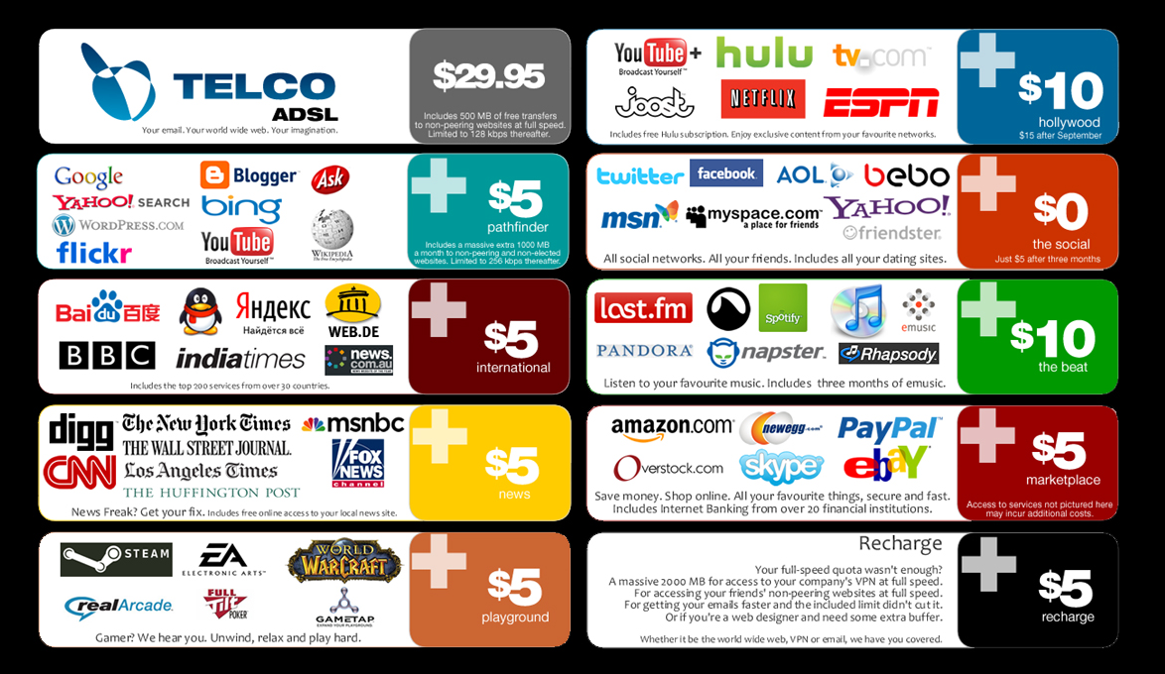

Slide 35
The Limits of Free Speech
The first amendment does not provide each idiot an apple box to shout from, nor obligate anyone to listen to them. You are free to speak – others are free to ignore you. Or at least, in most places, apparently.
The first amendment does not give you the right to violate personal property. This is part of the net neutrality argument. If the Internet is business, then business are private and your civil rights to freedom of expression do no apply to private property.

Slide 36
The Limits of Free Speech
A government may not force a person to endorse any symbol, slogan, or pledge.
Governmental restrictions on the "time, place, and manner" in which speech is permitted are constitutional if and only if:
they are "content neutral," both on their face and as applied;
they leave substantial other opportunities for speech to take place; and
they "narrowly serve a significant state interest."
On state-owned property that does not constitute a "public forum," government may restrict speech in any way that is reasonable in light of the nature and purpose of the property in question.

Slide 37
The Limits of Free Speech
Content-based governmental restrictions on speech are unconstitutional unless they advance a "compelling state interest." To this principle, there are six exceptions:

Slide 38
The Limits of Free Speech
Speech that is likely to lead to imminent lawless action may be prohibited.
"Fighting words" -- i.e., words so insulting that people are likely to fight back -- may be prohibited.
Obscenity -- i.e., erotic expression, grossly or patently offensive to an average person, that lacks serious artistic or social value -- may be prohibited.
Child pornography may be banned whether or not it is legally obscene and whether or not it has serious artistic or social value, because it induces people to engage in lewd displays, and the creation of it threatens the welfare of children.

Slide 39
The Limits of Free Speech
Defamatory statements may be prohibited. (In other words, the making of such statements may constitutionally give rise to civil liability.) However, if the target of the defamation is a "public figure," she must prove that the defendant acted with "malice."
Commercial Speech may be banned only if it is misleading, pertains to illegal products, or directly advances a substantial state interest with a degree of suppression no greater than is reasonably necessary.

Slide 40
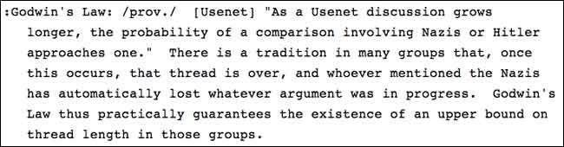
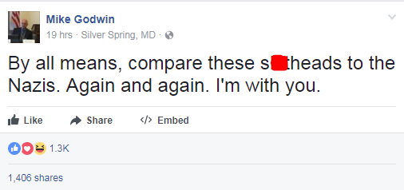
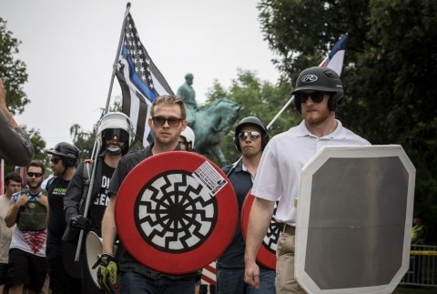
Godwin’s Law

Slide 41

Restricted speech, free speech, dangerous speech
Would you like to know more?

Slide 42
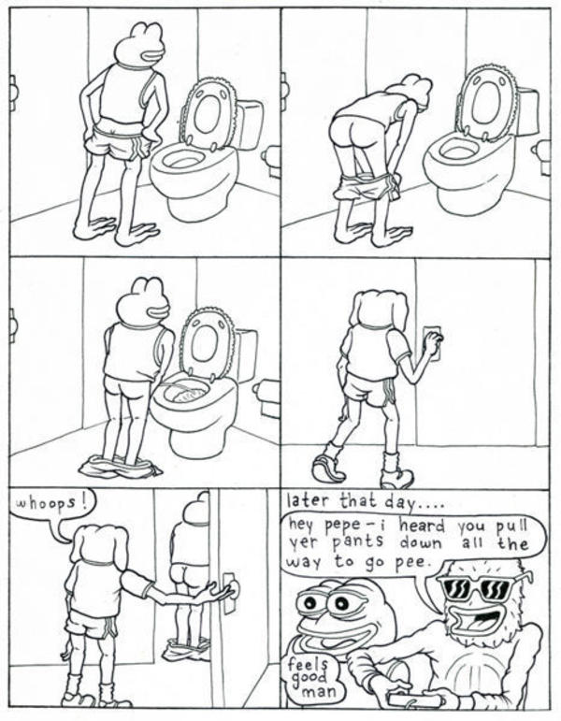
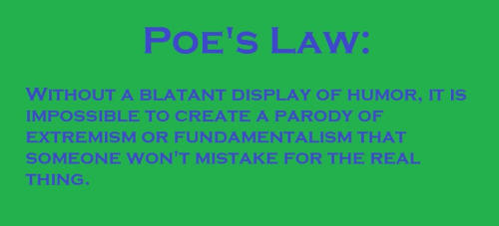

Poe’s Law

Slide 43
Threats
Threats are not protected speech, but the question is where mere talk becomes threatening – a line which is constantly being moved and interpreted according to the “reasonable person” standard.
Example: 1994 – US v. Alkhabaz aka. Jake Baker. Jake liked to write fictional stories of torture and sadism featuring his classmates at the University of Michigan. He shared them online, and when they came to light Baker was indicted for violations of the Interstate Communications statue (18 U.S.C. 875(c))
Would you like to know more?

Slide 44
Threats
The court ruled it was not a violation. In their view, a violation of 875(c) requires a demonstration that a reasonable person would perceive the communications as being conveyed "to effect some change or achieve some goal through intimidation." Baker's speech failed, in their judgment, to rise to this level.
“Baker's words were transmitted by means of the Internet, a relatively new communications medium that is itself currently the subject of much media attention. The Internet makes it possible with unprecedented ease to achieve world-wide distribution of material, like Baker's story, posted to its public areas. When used in such a fashion, the Internet may be likened to a newspaper with unlimited distribution and no locatable printing press - and with no supervising editorial control. But Baker's e-mail messages, on which the superseding indictment is based, were not publicly published but privately sent to Gonda.”
Would you like to know more?

Slide 45
Threats
CONTEXT IS EVERYTHING
Elonis v. United States – A man is convicted of making threats against his wife over the internet. He was depressed over his divorce and losing his job, and made a post online about killing his wife:
"There's one way to love you but a thousand ways to kill you. I'm not going to rest until your body is a mess, soaked in blood and dying from all the little cuts.“
Elonis claimed he was inspired by Eminem when he wrote the post:
“And mama said she wants to show how far she can float/ And don’t worry about that little boo-boo on her throat”
When confronted by the FBI, he returned to social media with another post:
"Little agent lady stood so close, took all the strength I had not to turn the bitch ghost. Pull my knife, flick my wrist and slit her throat."
Would you like to know more?

Slide 46
Libel / Defamation
A growing number of consumers are now being sued by businesses because of negative reviews posted on Yelp, Amazon, Angie’s List, RipOffReport and other online forums. In one case, a Virginia woman was found guilty of defaming a contractor who did work on her home — and the only reason she dodged $750,000 in damages is because the jury also found the contractor had defamed her on the same forum.
In Arizona, a woman was found liable for $12 million in damages for setting up a website to criticize two surgeons.

Slide 47
Libel / Defamation
While you may think it’s your right to complain about a bad experience online, you have to be careful. Even if you’re found not guilty of defamation, you could still have to pay lawyer’s fees and court costs to win the case.
The general rule of thumb is, if you post opinions, it’s not libelous — but if you make factual statements that can be proven to be untrue and harmful, you could be liable.

Slide 48
The 4th Amendment
The right of the people to be secure in their persons, houses, papers, and effects against unreasonable searches and seizures shall not be violated, and no warrants shall issue but upon probable cause, supported by oath or affirmation, and particularly describing the place to be searched and the persons or things to be seized.
Let’s think about the old days… The FBI suspects you are a dirty Commie and is going to investigate you for sedition. No computers yet, so they want to know:
Where you are staying
What you are reading
Your diary – if you keep one
Where you do your shopping
No problem there – all very clearly personal “effects” and “papers.”

Slide 49
Privacy on the Internet
When you send an email, you share it with numerous people along the way. You trust they won’t read it, but they could. There’s nothing inherent in the EULA or ToS of an email provider that says they won’t read it. In fact, there is likely language that says they will, if they feel like they have to.
In fact, all of your activity on the web is sent through multiple places. At the very least, your ISP is aware of your activity.
http://www.amazinginfographics.com/how-the-internet-works/
Law enforcement does not need to subpoena you for evidence. Your ISP will do. Or the servers anywhere else in the chain.
It is literally impossible to provide tangibility to something which, by design, is as intangible as the Internet.

Slide 50
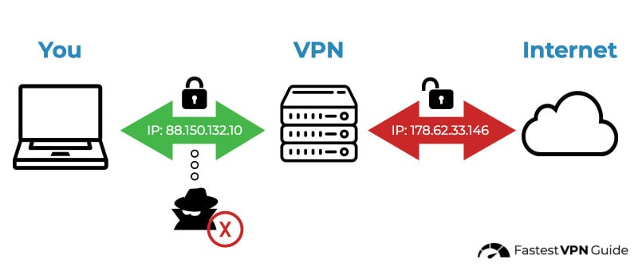
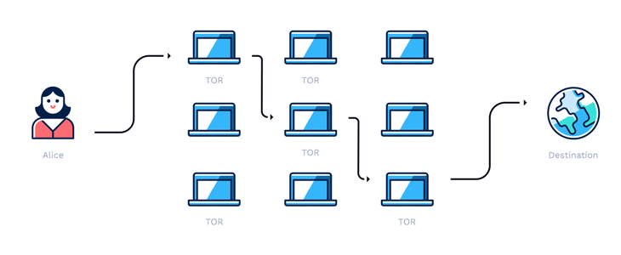
Privacy Enhancing Technologies – Communication Anonymizers
VPN
TOR / I2P

Slide 51
Privacy on the Internet
In Europe, citizens have a “right to be forgotten” – users of technological services have a right be exempt form data mining. The US has no such right, implicit or explicit.
Also consider that many events (birth, dead, divorce, etc) are matters of public record, indexed by search engines. Check out CCAP if you haven’t heard of it.
You might think – oh, it’s cool, always switch on the Do Not Track option. Most browsers today (Chrome, Firefox, Safari, Internet Explorer) do offer a do-not-track plugin — the only problem is, there’s no law requiring advertising companies to abide by it.

Slide 52
Privacy on the Internet
A fun experiment: Pick a house, any house. Many county tax assessors and websites such as Zillow or Trulia will have tons of information on it. It’s value, the owner’s name, etc. Then Google streetview will give you a close-up look at it. (For a while Google was even using their roaming streetview cars to collect unencrypted WiFi signals from people’s homes to build out an even better idea of demographics, but that is being challenged under the Wiretap Act.)

Slide 53
ECPA
Electronic Communications Privacy Act (ECPA) – Passed in 1986 and primarily governs how the government can access digital communications. Under this act, law enforcement agencies need a subpoena only, not a warrant, to obtain items older than 180 days.
How you feel about this is largely dependent on your experiences with technology. http://www.pewinternet.org/2016/01/14/privacy-and-information-sharing/

Slide 54
The 5th Amendment
No person shall be held to answer for a capital or otherwise infamous crime unless on a presentment or indictment of a grand jury, except in cases arising in the land or naval forces, or in the militia, when in actual service in time of war or public danger; nor shall any person be subject for the same offense to be twice put in jeopardy of life or limb; nor shall be compelled in any criminal case to be a witness against himself, nor be deprived of life, liberty, or property without due process of law; nor shall private property be taken for public use without just compensation.

Slide 55
Passwords
The 5th amendment protects you from incriminating yourself in the course of a criminal investigation. The question – is it something you KNOW or something you HAVE?
Something you KNOW is protected.
Something you HAVE is evidence. This includes fingerprints (biometric passwords), written notes, facial recognition, etc.
This has some pretty far-reaching implications – consider the case of a suspected arsonist who was charged with fraud when evidence from his pacemaker contradicted his story of escaping a house fire (no evidence of elevated heart rate.)

Slide 56
Passwords
This may also change, as someone was recently held in civil contempt for refusing to provide a passcode: https://assets.documentcloud.org/documents/4597748/Emergency-Writ.pdf
In any event, search procedure still applies to computer files and phones. Remember: Consent, warrant, exigent circumstances, or plain view.
iOS11 has a feature that gives users the best of both worlds: http://www.slate.com/blogs/future_tense/2017/08/18/the_new_iphone_update_will_help_prevent_cops_from_searching_your_locked.html Known as “cop lock”

Slide 57
Encryption
Can the court force a person to produce decrypted files or provide a password to decrypt files?
Usually no, but there are some circumstances that allow it.
United States v. Fricosu, held that the government can indeed force a suspect to use an encryption password if the testimony implicit in the use (i.e., the act of producing decrypted files) is already known to the government and/or the implicit testimony will not incriminate the suspect. The court ordered the defendant to produce decrypted files from her laptop because the government already knew (based on uncompelled testimony) that the files were on a computer that belonged to her and for which she had the password.
In short – Yes, if it’s a process of discovery, not of investigation.

Slide 58
5th Amendment in a Nutshell
The Fifth Amendment does not protect against the production of non-testimonial evidence.
Thus, a person may be required to provide blood samples or handwriting exemplars, appear in a line-up, or speak aloud for voice identification.
However, the Fifth Amendment does protect against the production of evidence that discloses the contents of a defendant’s mind, including his or her beliefs and knowledge.
Moreover, the amendment protects against any production that would compel a defendant to restate, repeat or affirm the truth of statements contained in documents sought.

Slide 59
The 6th Amendment
In all criminal prosecutions, the accused shall enjoy the right to a speedy and public trial by an impartial jury of the state and district wherein the crime shall have been committed, which district shall have been previously ascertained by law, and to be informed of the nature and cause of the accusation; to be confronted with the witnesses against him; to have compulsory process for obtaining witnesses in his favor; and to have the assistance of counsel for his defense.

Slide 60
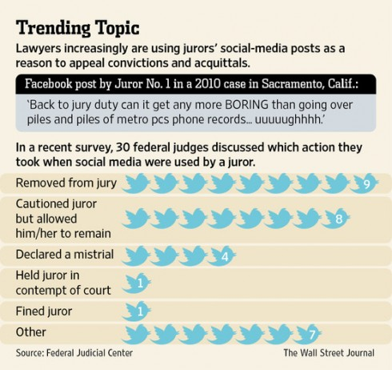
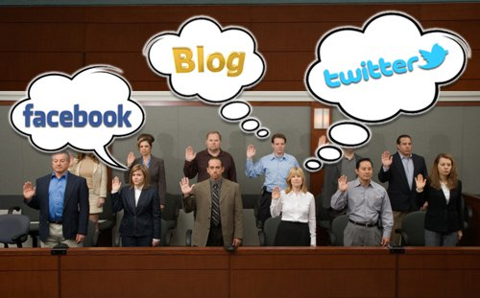
The Court of Public Opinion
To safeguard a defendant’s Sixth Amendment right to an impartial jury, jurors must “set aside preconceptions, disregard extrajudicial influences, and decide guilt or innocence ‘based on the evidence presented in court.’” Yet, juror misconduct is trending upwards as jurors are communicating via social media about the trials in which they are participating.
For instance, some jurors have used Facebook and Twitter to describe trials and elicit opinions from friends and family on how to decide a particular case.
Other jurors have expressed opinions pertaining to guilt or innocence, with one juror posting a Facebook status stating the defendant was “presumed guilty.”

Slide 61
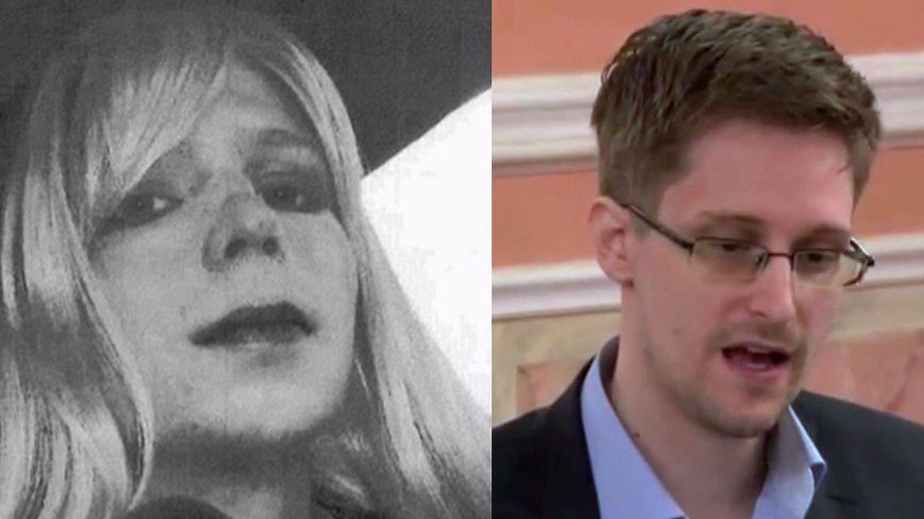
In our era of instant global communication, is an “impartial” trial even possible?
No, but that doesn’t stop us from trying.

Slide 62
Digital citizenship
The Internet cannot exist without participation. It is the repository for all human information because someone took the time to put it there.
It is a running record of the global zeitgeist because people post their thoughts to the public.
Does this also give us a responsibility in an ethical sense to moderate content – or an ethical responsibility to not moderate content?

